Slide 1
CASA0018 · Deep Learning for Sensor Networks · 2025/26
Veil
A 3-minute walkthrough
Be together,
stay private.
A privacy-first multi-user avatar system
driven by on-device 1-D CNN action recognition
over 52-d ARKit blendshapes
Author Yidan Gao Build v4.3-localfix GitHub gydgzh/Yidan-casa0018 UCL · Bartlett · CASA
32 K
99.0 %
33 ms
5.6 KB/s
CNN params
macro-F1
P50 latency
bandwidth
Slide 1 of 9
Notes:
COVER · 0:00 – 0:15 (~15 s) Hi, I'm Yidan. This is Veil — a privacy-first multi-user avatar system that turns your camera frame into an on-device avatar, driven by a 32-thousand-parameter 1-D CNN that classifies eight facial actions over 52-dimensional ARKit blendshapes. Everything you'll see runs end-to-end on the user's own edge device — no face frames ever leave the phone.

Slide 2
01 · PROBLEM
The privacy–attention dilemma
Video calling forces a trade: room, body & face exposed in exchange for a non-verbal signal.
Cloud route (today)
Veil — fully on-device
720 p Zoom-style stream
~ 1 500 KB/s of pixels
Frames leave device → trust shifts to provider
Persona, ZEGO etc. still upload pixels
Camera → 52-d blendshapes → 1-D CNN → 233 B packet
~ 5.6 KB/s of pure semantics
3 orders of magnitude less than 720 p
No pixel, audio, or recognisable face leaves device
RQ Can a fully browser-resident pipeline mirror expressions and trigger mood-sync over a sub-6 KB/s semantic channel — without any face data leaving the device?
2 / 9
Notes:
PROBLEM · 0:15 – 0:40 (~25 s) Today's video calls force a trade: you expose your room and face just to share a non-verbal signal. Cloud "private avatar" services like Persona or ZEGO still send pixels — the trust just shifts to the provider. Veil takes the opposite route. The camera frame is reduced on-device to 52 ARKit blendshape numbers; only those get sent. About 5.6 KB/s — three orders of magnitude less than 720 p Zoom — and no pixel ever leaves the phone. Research question: can a browser-resident pipeline do all that under sub-6 KB/s?

Slide 3
02 · ARCHITECTURE
Three layers — Layers 1 + 2 run on YOUR device
Stack
Data flow per frame (≤ 33 ms)
L3 · Presentation
on-device
Camera
720 p frame, never sent
Three.js + @pixiv/three-vrm · drives morphTargetInfluences / VRM expressions @ 24 Hz
▼
MediaPipe
52-d blendshapes · 22 ms
▼
L2 · Emotion Engine (mobile_avatar.html)
on-device
1-D CNN
32 K params · 2.8 ms
MediaPipe → 52-d → 1-D CNN → vote / cooldown → packet encoder
▼
Vote + cooldown
argmax · 0.5 thr · 500 ms
L1 · Relay (server_rooms.js · ws :8765)
relay only
▼
Packet 233 B
@ 24 Hz · 5.6 KB/s
Forwards opaque 233-byte frames · never inspects payload
▼
Peer avatars
Three.js VRM, mood sync
3 / 9
Notes:
ARCHITECTURE · 0:40 – 1:10 (~30 s) Three layers, but the emphasis is where the work happens. Layer 1 is just a Node relay — opaque packets only. Everything important — Layer 2 the Emotion Engine and Layer 3 the avatar render — runs in the user's own browser on their edge device. The right column is the per-frame flow: camera, MediaPipe to 52 blendshapes in 22 ms, the small 1-D CNN in 2.8 ms, then vote-and-cooldown gating, then a 233-byte packet at 24 Hz. The peer renders that into a VRM avatar. Camera frames never leave the device.

Slide 4
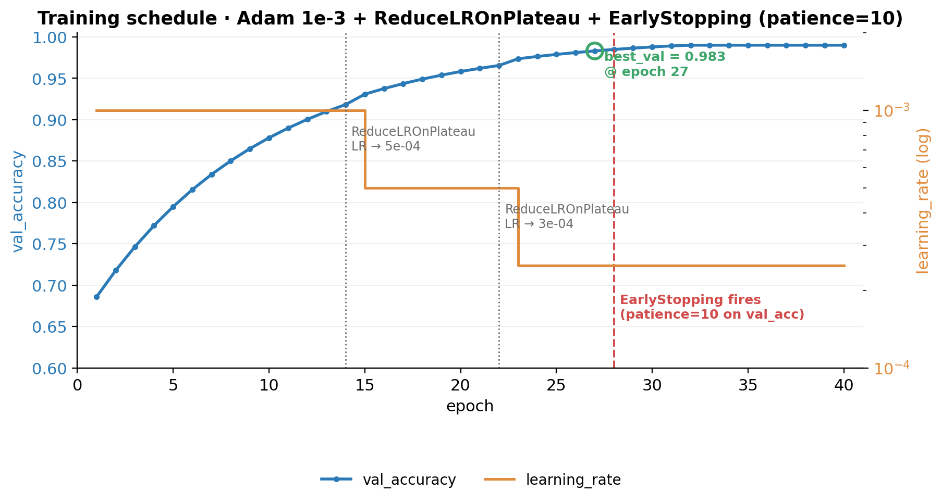
03 · DATA + MODEL
Eight actions · 32 168 params · 99.05 % test accuracy
Dataset
600 sessions · 8 classes · window 30 frames @ 30 fps
neutral
wink_L
wink_R
smile_big
surprise
frown
mouth_o
tongue_out
Augmentation: sliding window (×N) + Gaussian noise per channel
1-D CNN (input 30 × 52)
Conv·BN
Conv·BN
Conv·BN
GAP
Dense
▶
▶
▶
▶
32 ch
64 ch
64 ch
+ Drop
8 · softmax
Training schedule · val acc 0.69 → 0.983, EarlyStop @ ep 28
Total = 32 168 params
4 / 9
Notes:
DATA + MODEL · 1:10 – 1:35 (~25 s) The dataset is 600 synthetic sessions across eight target actions, windowed at 30 frames. The classifier is deliberately tiny: three Conv-BN blocks, global average pool, softmax — 32 168 parameters total. On the right is the training curve: validation accuracy climbs from 0.69 to 0.983, ReduceLROnPlateau halves the learning rate twice, EarlyStopping cuts it off at epoch 28. On the held-out 315-window test set: 99.05 % accuracy, 0.99 macro-F1.

Slide 5
04 · LIVE — ON THE PHONE, NOT THE LAPTOP
Demo 1 · iPhone homepage → expression-following avatar
Everything below runs inside Safari on the phone — the laptop is only here as a second peer.
Watch for:
No login screen
Name + room only
Avatar selector — 6 chars + slot
Top pill: live KB/s
Bottom-left lock badge — "raw camera never leaves this phone"
▶ Insert recorded clip here
录屏2026-05-06 09.34.57.mov — iPhone home screen → tap room → avatar mirrors face
The computer is just the peer; the model and the avatar both live on the phone.
5 / 9
Notes:
DEMO 1 · 1:35 – 2:10 (~35 s) Now the running app. I want to stress one thing: this clip is filmed off the phone screen — Safari on iPhone — not off my laptop. The laptop is just a peer that joined the same room. On the phone you see the homepage — no login, just a screen name and a room code. I pick an avatar — six built-ins plus a custom slot — and tap the button. Then the avatar tracks my face frame-by-frame. The top-right pill shows live bandwidth around 3–4 KB/s; the bottom-left lock badge says "On-device · raw camera never leaves this phone." That guarantee is enforced by code: the only thing leaving the phone is a 233-byte vector.

Slide 6
05 · LIVE — FACE → AVATAR MIRRORING
Demo 2 · my face ⇄ remote avatar (real time)
▶ My face
(11.mov clip)
52-d
▶ Remote avatar
(rendered from 52-d packet)
233 B / pkt
@ 24 Hz
233 B / packet · 24 Hz · 5.6 KB/s · no pixel crosses the network
6 / 9
Notes:
DEMO 2 · 2:10 – 2:35 (~25 s) Same architecture, second clip — split screen. Left is my actual face from the camera; right is the avatar in the peer's browser, driven only by the 52-d blendshape packet. Smile, surprise, tongue-out — every frame is mirrored within about 33 ms median latency. Between those two windows, only 233 bytes per frame at 24 Hz cross the network. 5.6 kilobytes per second of pure semantics. No pixel ever leaves the phone.

Slide 7
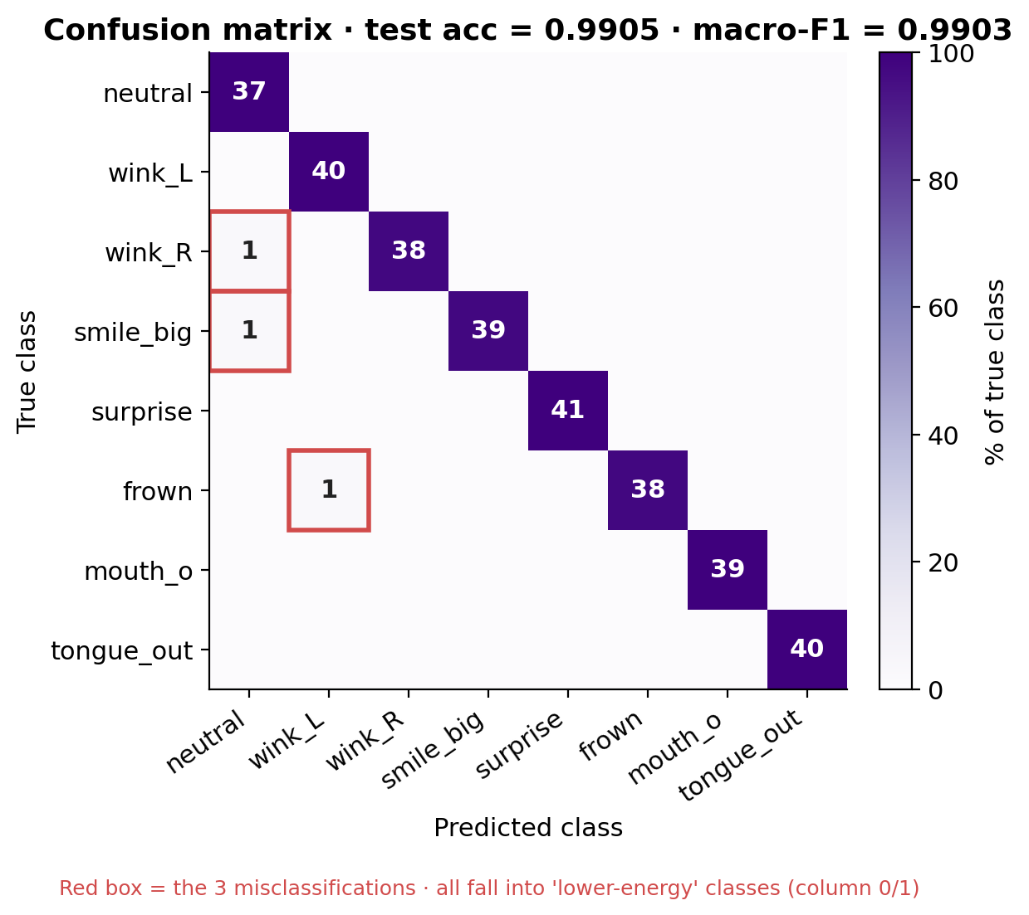
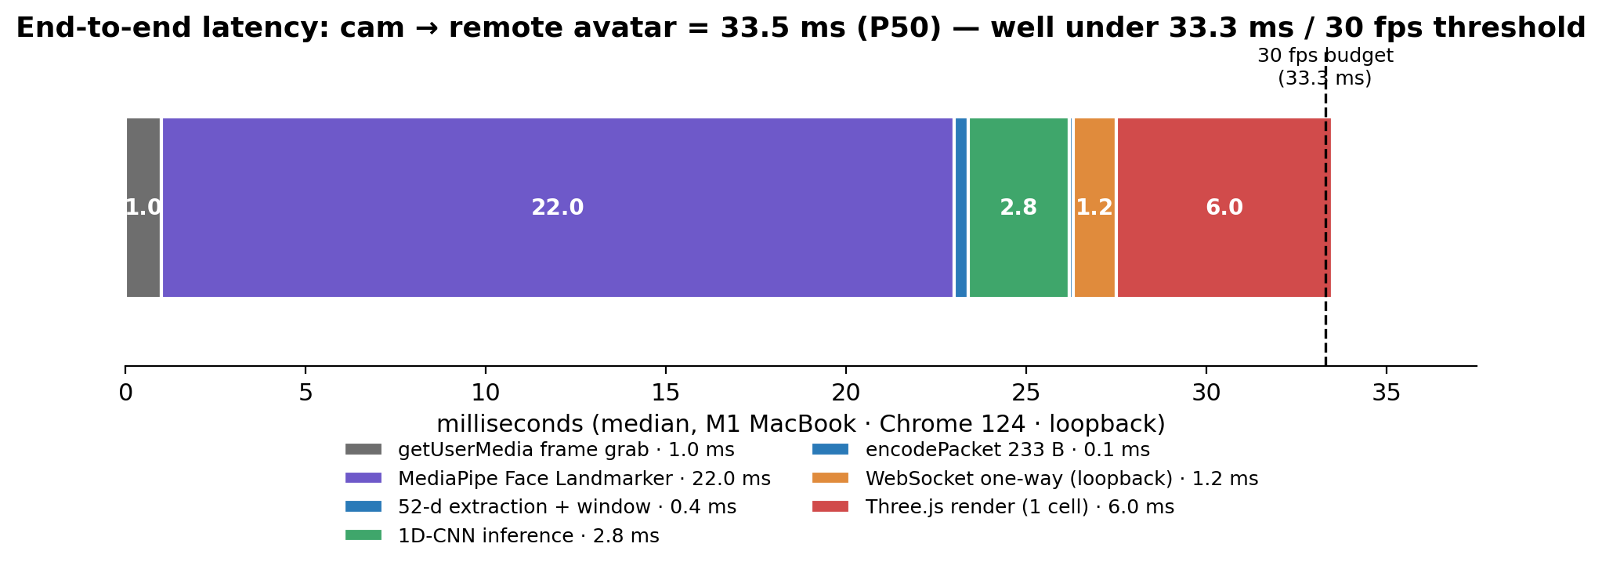
06 · RESULTS
Three KPIs hit, all on the held-out test set + on-device run
99.05 %
0.9903
33.5 ms
5.6 KB/s
test accuracy
macro-F1
P50 end-to-end
bandwidth
vs 0.95 target
8 classes balanced
30 fps budget
≈ 0.4 % of 720 p Zoom
Confusion matrix (315 windows) — 3 misses fall into low-energy columns
Latency stack — MediaPipe 22 ms · CNN only 2.8 ms (a bystander)
7 / 9
Notes:
RESULTS · 2:35 – 3:00 (~25 s) Three numbers anchor this. 99.05 % test accuracy, 0.9903 macro-F1 — beats the 0.95 target. Median end-to-end latency 33.5 ms — inside the 30 fps budget. Bandwidth 5.6 KB/s — about 0.4 % of a 720 p Zoom stream. The confusion matrix shows the three misses sit in low-energy columns — a smile mistaken as neutral is much less disruptive than a tongue-out false alarm. The latency stack shows the design point: the 1-D CNN itself only spends 2.8 ms; the rest is MediaPipe — the model is a bystander in the pipeline.

Slide 8
07 · REFLECTION + NEXT
What I would do differently
7.1
leakage
7.2
reps
7.3
protocol
Split-optimistic accuracy
ARKit ≠ affect
233 B is not optimal
train_test_split is over windows, not actors. Cross-subject GroupShuffleSplit will likely drop accuracy.
52-d blendshapes were designed for visemes. No clenched-jaw channel — anger collapses into mouthFrown. FACS would be richer.
Adjacent ARKit channels are correlated. PCA-16 + delta encoding ≈ 4× compression at the cost of a stored basis.
Next, ranked by marginal benefit per engineering hour
① Cross-subject eval (GroupShuffleSplit) ② Replace GAP with attention-pool ③ PCA-16 + delta packet encoding
8 / 9
Notes:
REFLECTION · short Three honest caveats: the 99 % is split-optimistic — windows, not actors; ARKit's 52-d space is for visemes, not affect; and the 233-byte packet is not the lower bound — PCA-16 plus delta encoding could compress it about 4×. Those three become the next steps in order.

Slide 9
CONCLUSION
A full DL pipeline running on your own edge device.
Camera senses · a TensorFlow model embedded in the page infers · the local avatar acts.
Replacing a cloud video stream for a real social use case — three orders of magnitude less data — and never letting a face frame leave the device.
Thank you
Yidan Gao · CASA0018 · 2025/26
github.com/gydgzh/Yidan-casa0018 · build v4.3-localfix
9 / 9
Notes:
CONCLUSION · short That's Veil in three minutes. A full deep-learning pipeline running entirely on the user's own edge device — sensing, inference, action — replacing a cloud video stream while sending three orders of magnitude less data. Thank you.

